Slide 1


Department of Artificial Intelligence and Data Science
WILD FIRE PREVENTION USING AI/ML
Team Members:
Atharva Sardal
Ashish Patil
Aum Kulkarni
Sanika Dhuri
Guide Name:
Mrs. Sangeeta Oswal
AI-FOR-GOOD

Slide 2
CONTENT TABLE
INTRODUCTION
OBJECTIVES
PROBLEM STATEMENT
DISCUSSION ABOUT DATA SET PARAMETERS
DATA SET PRE-PROCESSING AND CLEANING
MODEL TRAINING
REFERENCES AND CONCLUSION

Slide 3
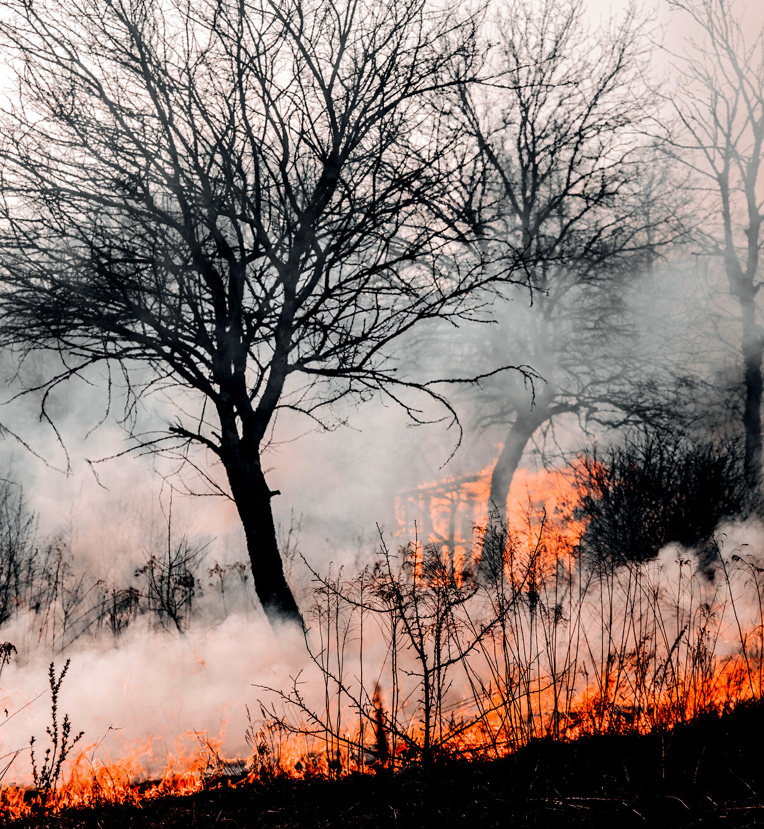

INTRODUCTION
NEED & RELEVANCE
They pose a threat not only to the forest wealth but also to the entire regime of fauna and flora seriously disturbing the ecology and environment of a region.
When there is no rain for months, the forests become littered with dry senescent leaves and twinges, which could burst into flames ignited by the slightest spark

Slide 4

Objectives
To study and evaluate various machine learning models
Using machine learning model to predict information about forest fires

Slide 5

Problem statement
Every year forest fires destroy a huge area of forest cover, leaving large-scale destruction of flora and fauna in it's wake. Devise an effective solution to minimize their effects using AI/ML

Slide 6
About the Data set
Obtained on UCI-repository
Country Specific data set based in Portugal
Time of Data set creation-2008
Data Set height- 517 rows
Total Data Points : (517*13)=6721
NO NULL VALUES

Slide 7
1. X - x-axis spatial coordinate within the Montesinho park map: 1 to 9
2. Y - y-axis spatial coordinate within the Montesinho park map: 2 to
3. month - month of the year: 'jan' to 'dec'
4. day - day of the week: 'mon' to 'sun'
5. FFMC - FFMC index from the FWI system: 18.7 to 96.20
6. DMC - DMC index from the FWI system: 1.1 to 291.3
7. DC - DC index from the FWI system: 7.9 to 860.6
8. ISI - ISI index from the FWI system: 0.0 to 56.10
9. temp - temperature in Celsius degrees: 2.2 to 33.30
10. RH - relative humidity in %: 15.0 to 100
11. wind - wind speed in km/h: 0.40 to 9.40
12. rain - outside rain in mm/m2 : 0.0 to 6.4
13. area - the burned area of the forest (in ha): 0.00 to 1090.84

Slide 8

About FFMC,DMC ,ISI,BUI,DC
The Canadian Forest Fire Weather Index (FWI) System consists of six components that account for the effects of fuel moisture and weather conditions on fire behavior.
They are- FFMC,DMC,DC,ISI,BUI

Slide 9
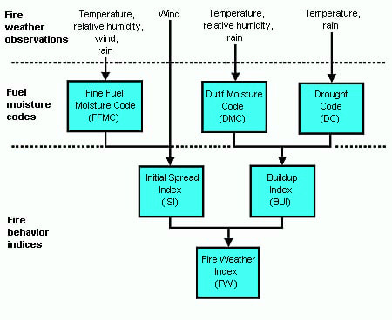

Slide 10

Data pre-processing
Three steps have been performed in data preprocessing:
Up sampling
Reducing Skewness
One Hot encoding of categorical columns

Slide 11

UPSAMPLING:
Upsampling is a procedure where synthetically generated data points (corresponding to minority class) are injected into the dataset. After this process, the counts of all the labels are almost the same. This equalization procedure prevents the model from inclining towards the majority class

Slide 12
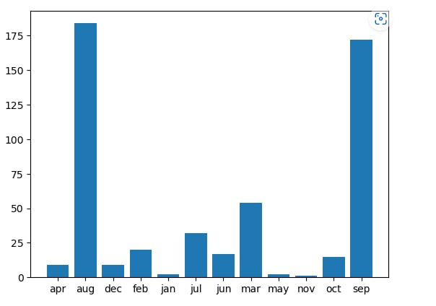
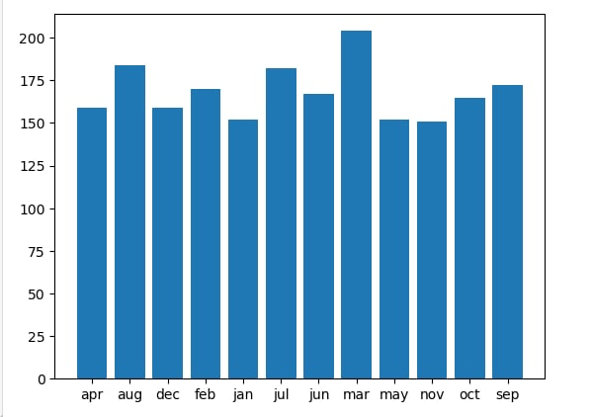
DATA SET BEFORE UPSAMPLING
517
DATA SET AFTER UPSAMPLING
*The data points for the months have been equalized
2017

Slide 13
Reducing Skewness:
As the area column of the data set is very skewed to towards zero, we take the log of the area to reduce it skewness

Slide 14
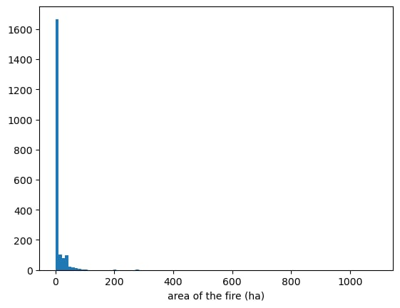
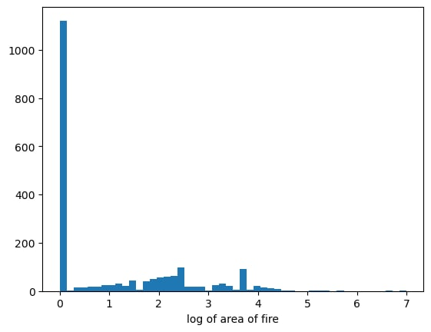
Before taking Log
After taking Log

Slide 15
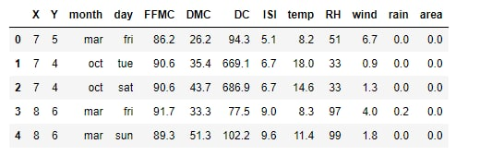
One-Hot encoding
The categorical columns of months and the days are one hot encoded to create separate columns for each month and day

Slide 16
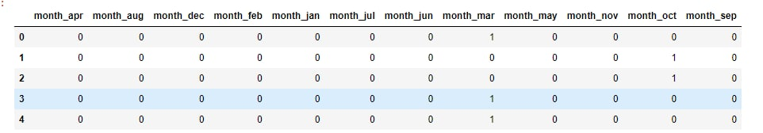
After One-hot encoding

Slide 17

MODEL-TRAINING
Methods used for training the model are:-
Linear Regression: Linear Regression is a supervised learning algorithm that aims to draw the best fit line that has the least mean squared error.
Support Vector Regression: Support Vector Regression is a supervised learning algorithm that is used to predict discrete values. It is based on the concept of Support Vector Machines (SVM). The aim of this model is to find the best fit hyperplane that includes the maximum amount of points.

Slide 18

MODEL-TRAINING
Hyperparameters:-
kernel: the kernel type to be used. The most common kernels are rbf
(this is the default value), poly or sigmoid, but you can also create your own kernel. RBF has been used
C (Regularization parameter): Tells the SVM optimization how much you want to avoid miss classifying each training example. A C value of 1 is taken
gamma: The gamma parameter defines how far the influence of a single training example reaches. Lower the value of gamma, more number of data points a greater distance will be considered. A gamma value of 1 is taken.
*All the features have been scaled to using Standard Scaler of scikit-learn library before training the model

Slide 19
MODEL-TRAINING
Evaluation Metrics:
MSE(mean square error):
The Mean Squared Error measures how close a regression line is to a set of data points.
MAE(mean Absolute error):
Its the measure of errors between two set of paired inputs expected to give the same outcome

Slide 20
MODEL-TRAINING
Evaluation Metrics:
R2 Score:
The R2 coefficient of determination measures how well the regression predictions approximate the real data points. An R2 of 1 indicates that the regression predictions perfectly fit the data.

Slide 21

Model Evaluation for SVR Model
Mean Squared Error: 0.4493
Mean Absolute Error: 0.3127
R2 Score: 0.7585

Slide 22
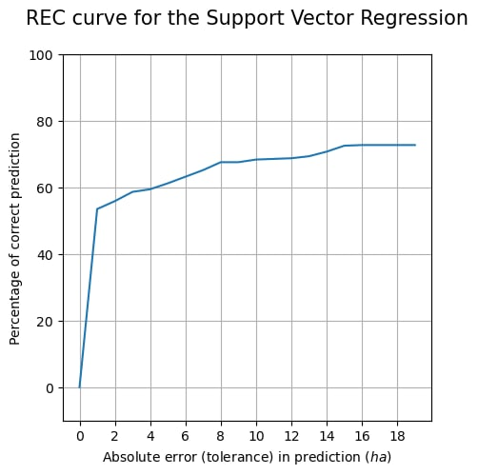
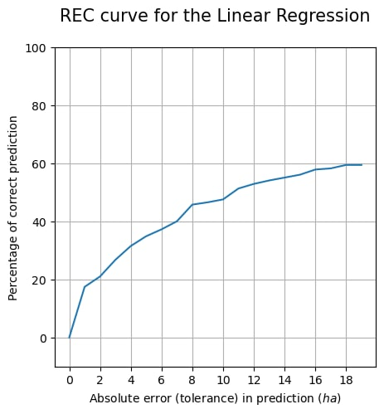
REC curves analysis
*regression characteristic Curves
The SVR predicts more than 50% of the points within a tolerance of 2%
Linear Regression which predicts only about 20% within a tolerance of 2%:

Slide 23
REFERENCES:
Forest Fires Detection Using : Machine Learning Techniques
https://www.researchgate.net/publication/344462171_Forest_Fires_Detection_Using_Machine_Learning_Techniques
A Tour of Machine Learning : Algorithms
https://machinelearningmastery.com/a-tour-of-machine-learning-algorithms/
A Data Mining Approach to : Predict Forest Fires using Meteorological Data
http://www3.dsi.uminho.pt/pcortez/fires.pdf

